Slide 1
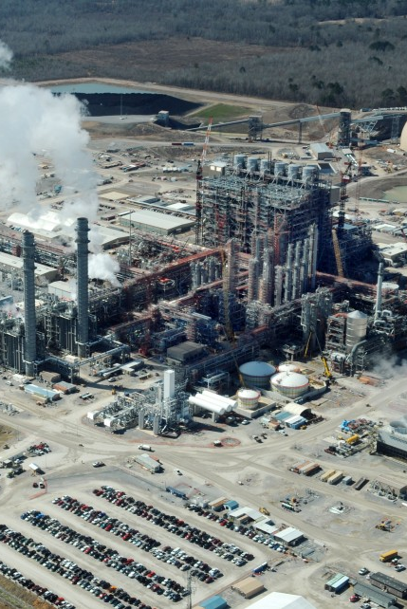
A presentation on the project
Designing a 130 MW IGCC Power Plant with Carbon Capture
Md Tariful Islam 1502015
Mahbub Chowdhury 1502016
Suprio Kamal 1502026
MD. Shahriar Hossain 1502033
Dept. of Chemical Engineering
BUET

Slide 2
Project Definition
A Municipal Solid Waste (MSW) based Integrated gasification combined cycle (IGCC) power Plant having a capacity of 130MW alongside Carbon capture will be set up on the bank of Buriganga river, near the major dumping site of Dhaka..
Process Features
Geographical Data
Meteorological Data
Raw Material Specification

Slide 3
Features
MSW is a low cost fuel
Compatible with gasification process.
Reduce landfill usage
Efficient Thermal conversion
Can become a carbon negative process
Low emission to environment
Offsets the use of fossil fuel

Slide 4
Raw Material Specification: MSW
Waste Type %Composition
Food waste 73.20
Wood 5.36
Paper 9.65
Cloth 8.57
Plastics 3.22

Slide 5
Raw Material Specification: MSW
Proximate Analysis
Components %Composition
Ash 12.47
Volatile Carbon 75.83
Fixed Carbon 11.69

Slide 6
Raw Material Specification: MSW
Ultimate Analysis
Components %Composition
Carbon 47.61
Hydrogen 6.07
Oxygen 43.85
Nitrogen 2.19
Sulfur 0.28

Slide 7
Raw Material Specification: Coal
Proximate Analysis
Components %Composition
Ash 6.4
Volatile Carbon 48.46
Fixed Carbon 45.14

Slide 8
Raw Material Specification: Coal
Ultimate Analysis
Components %Composition
Carbon 55.34
Hydrogen 5.07
Oxygen 24.7
Nitrogen 5.46
Sulfur 0.51

Slide 9
Stack Gas Composition
Component Mole fraction(%)
N₂ 68.20
H₂O 16.31
O₂ 10.12
CO₂ 4.98
NO 0.33
CO 0.04
H₂ 0.02
CH₄ 0

Slide 10
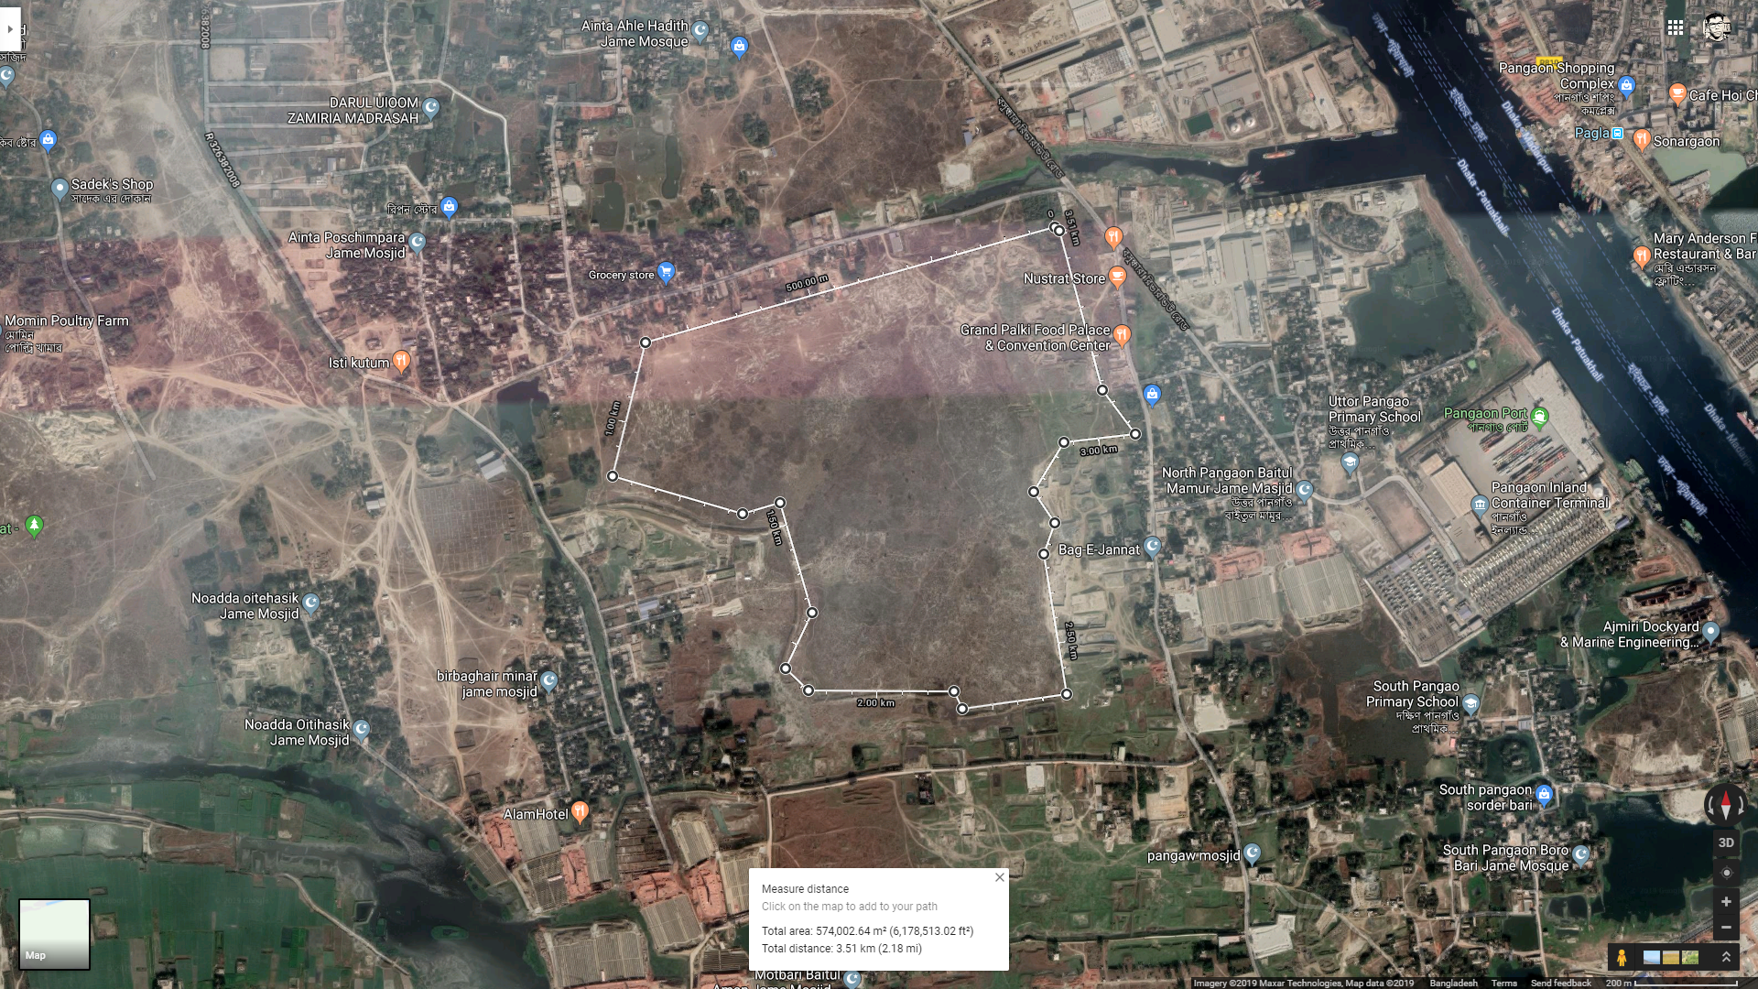

Location : Geography
Notes:
141.8 Acre

Slide 11
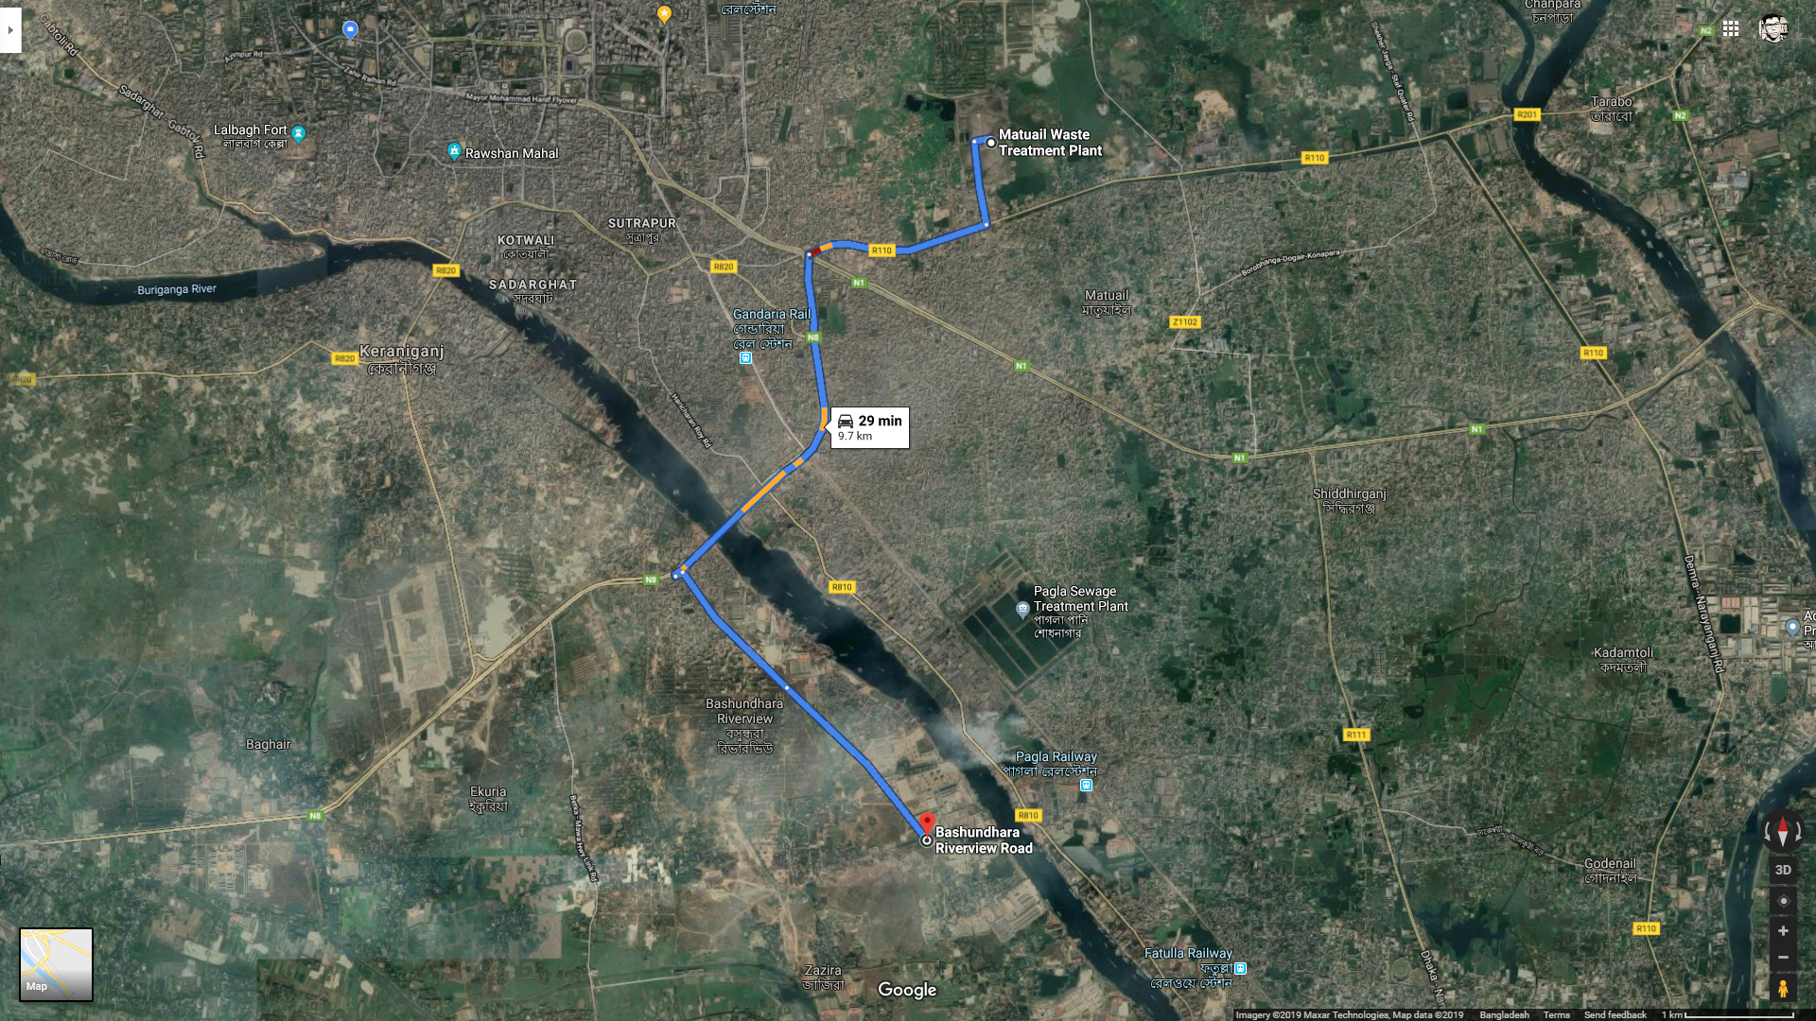

Location : Geography
Near the major dumping site for Dhaka
Flat terrain
Beside Buriganga, facilitating shipping
Almost 10 km
from Matuail

Slide 12
Location : Meteorology
Temperature
Average Humidity
Wind Speed
Rainfall

Slide 13
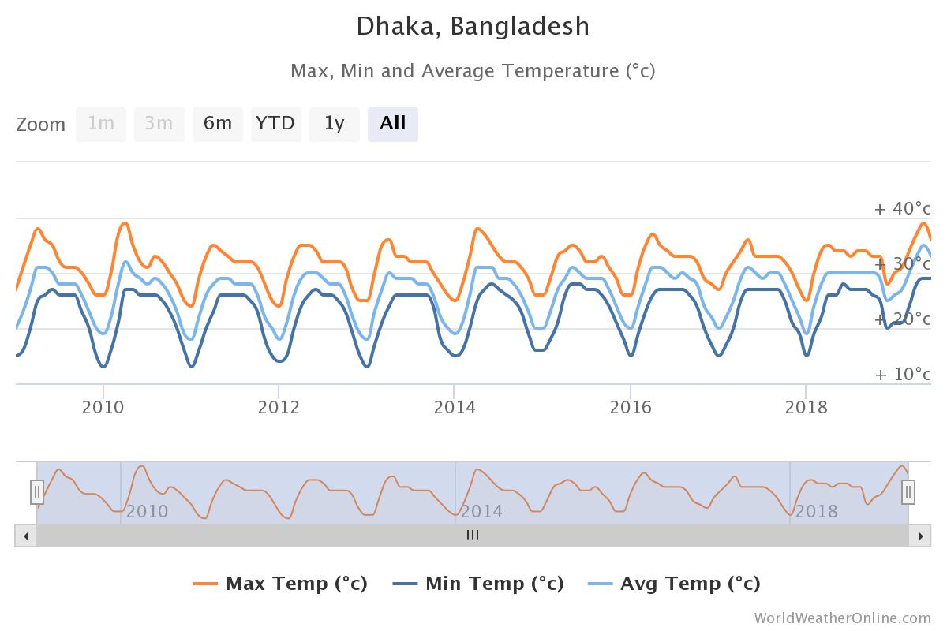
Location : Temperature
High temperature at April-September
Lowest at November-February
Max average yearly temperature = 35ºC
Min average yearly temperature = 20ºC

Slide 14
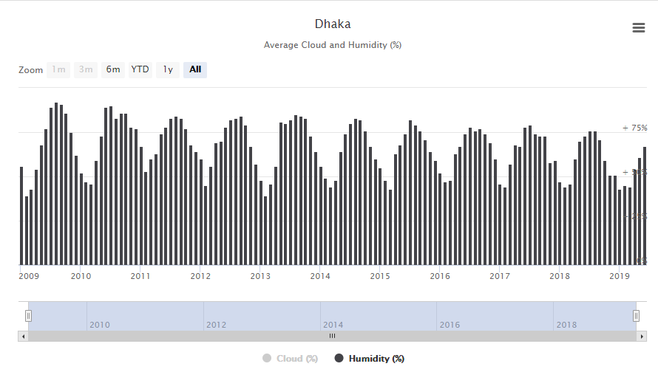
Location : Average Humidity
Varies from 75% to 40%
Average at 60%
75%
50%
25%

Slide 15
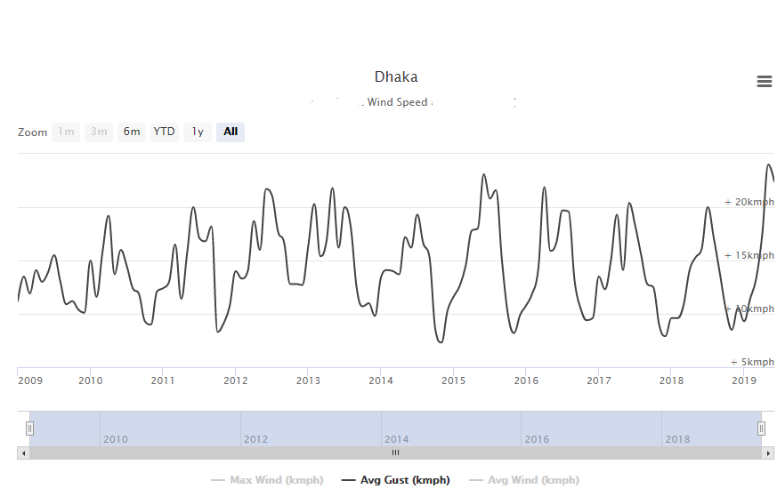
Location : Wind Speed

Slide 16
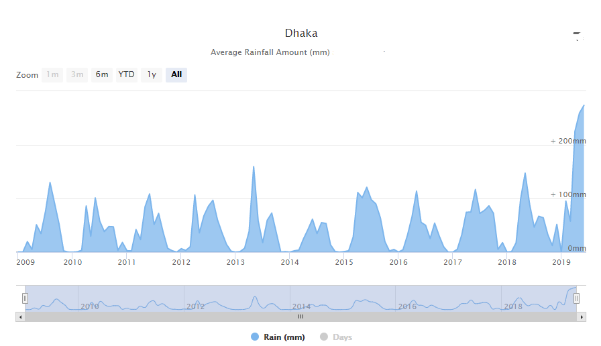
Location : Rainfall
Average annual rainfall = 2148 mm
Maximum monthly rainfall = 373.1 mm
Average monthly rainfall = 179 mm

Slide 17
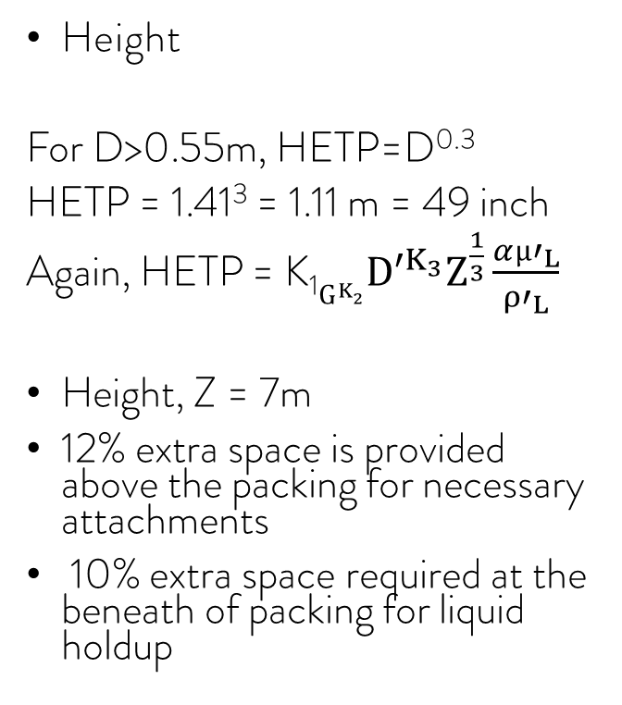
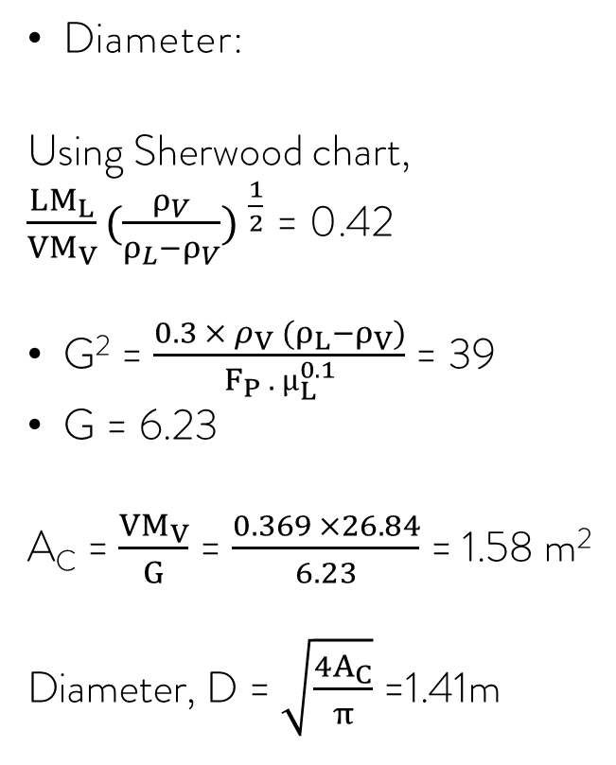
Design: CO₂ Capture Stripper Column
Diameter:
Using Sherwood chart,
$\frac{LM_{L}}{VM_{V}}{(\frac{ρ_{V}}{ρ_{L}−ρ_{V}}) }^{\frac{1}{2}}$ = 0.42
G² = $\frac{0.3 × ρ_{V} (ρ_{L}−ρ_{V})}{F_{P} . µ_{L}^{0.1}}$ = 39
G = 6.23
A_{C} = $\frac{VM_{V}}{G}$ = $\frac{0.369 ×26.84}{6.23}$ = 1.58 m²
Diameter, D = $\sqrt{\frac{4A_{C}}{π}}$ =1.41m
Height
For D>0.55m, HETP=D^{0.3}
HETP = 1.41³ = 1.11 m = 49 inch
Again, HETP = K₁$G^{K_{2}}D^{{′K}_{3}}Z^{\frac{1}{3}}\frac{α{µ′}_{L}}{{ρ′}_{L}}$
Height, Z = 7m
12% extra space is provided above the packing for necessary attachments
10% extra space required at the beneath of packing for liquid holdup

Slide 18
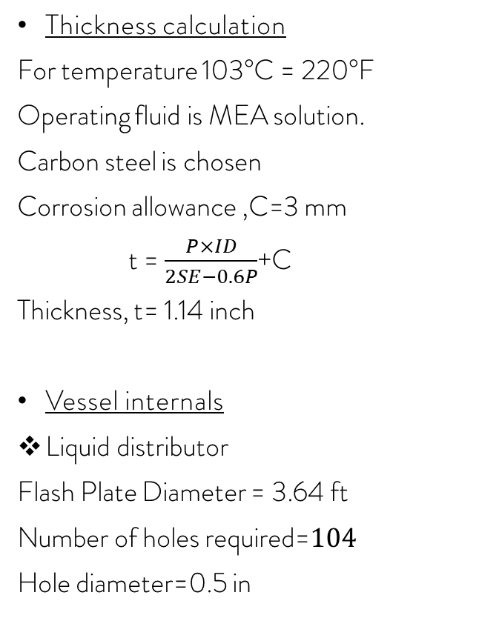
Design: CO₂ Capture Stripper Column
Thickness calculation
For temperature 103°C = 220°F
Operating fluid is MEA solution.
Carbon steel is chosen
Corrosion allowance ,C=3 mm
t = $\frac{P×ID}{2SE−0.6P}$+C
Thickness, t= 1.14 inch
Vessel internals
Liquid distributor
Flash Plate Diameter = 3.64 ft
Number of holes required=$104$
Hole diameter=0.5 in
Liquid Redistributor
For random packing Liquid redistributor is required at 3D distance interval
Number of liquid distributor =2
Weight of the Tower Calculation
Maximum weight of tower, Wmax = Ws + W_{T} + Wa
Where,
Ws= Shell Weight
W_{T} = Weight of shell during water test
Wa =Weight of attachment
Wmax=55807 kg

Slide 19
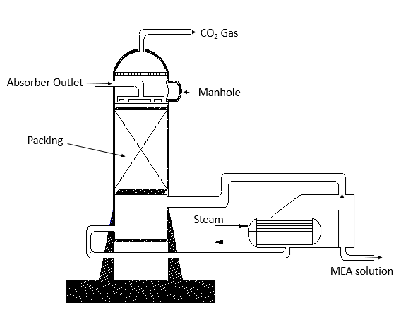
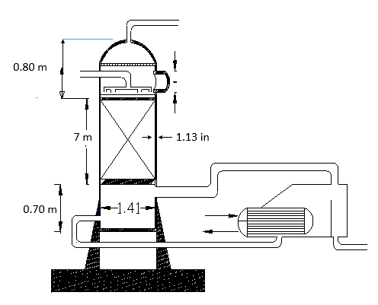
Schematic: CO₂ Capture Stripper Column

Slide 20
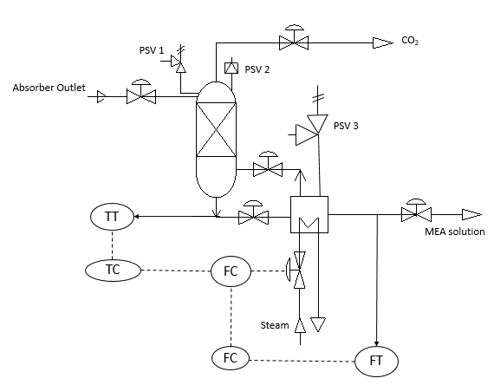
P&ID: CO₂ Capture Stripper Column

Slide 21
Process Selection
Conventional Combustion Process
Integrated gasification and combined cycle(IGCC) process
Feedstock is burned completely to produce steam
Electricity is produced through steam turbine
Feed is gasified with shortage of oxygen
Impurities are removed before power generation cycle
Syngas produced is the fuel for gas turbine
Syngas cooler and gas turbine exhaust through HRSG make steam for the steam turbine cycle
Advantages of IGCC Process
Wide range of feedstock
Environment friendly and less pollution
Easier carbon capture
Dense pollutants easy to remove
Less water needed
Higher efficiency

Slide 22
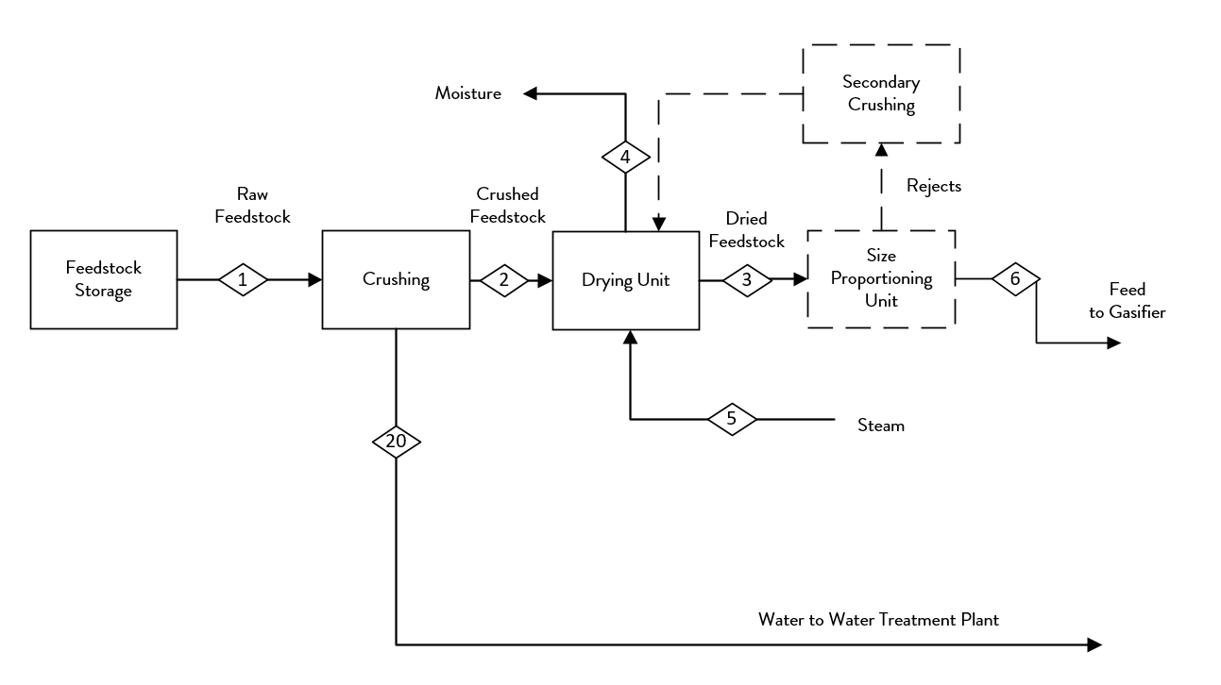
Process Block Diagram
Feedstock Preparation

Slide 23
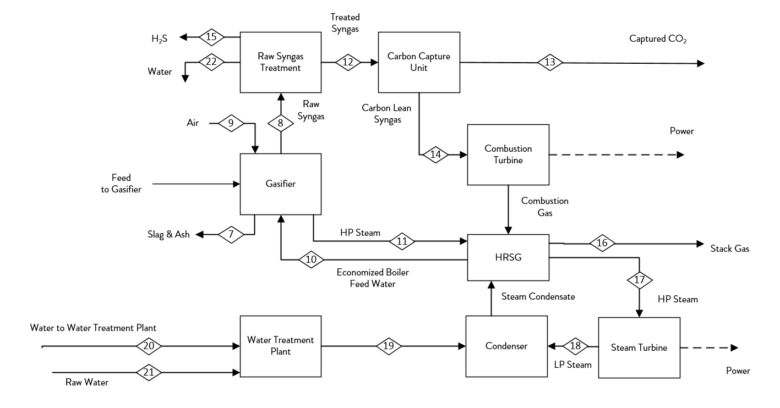
Process Block Diagram
Overall Process

Slide 24
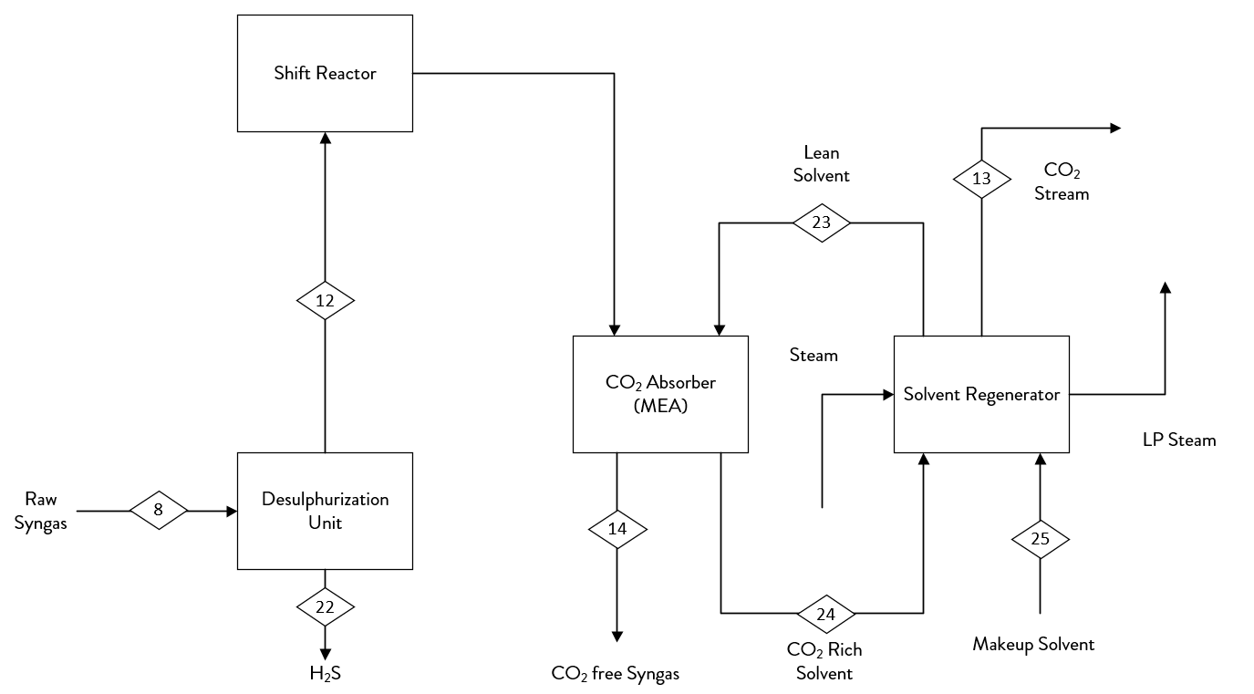
Process Block Diagram
Raw Syngas Cleaning

Slide 25
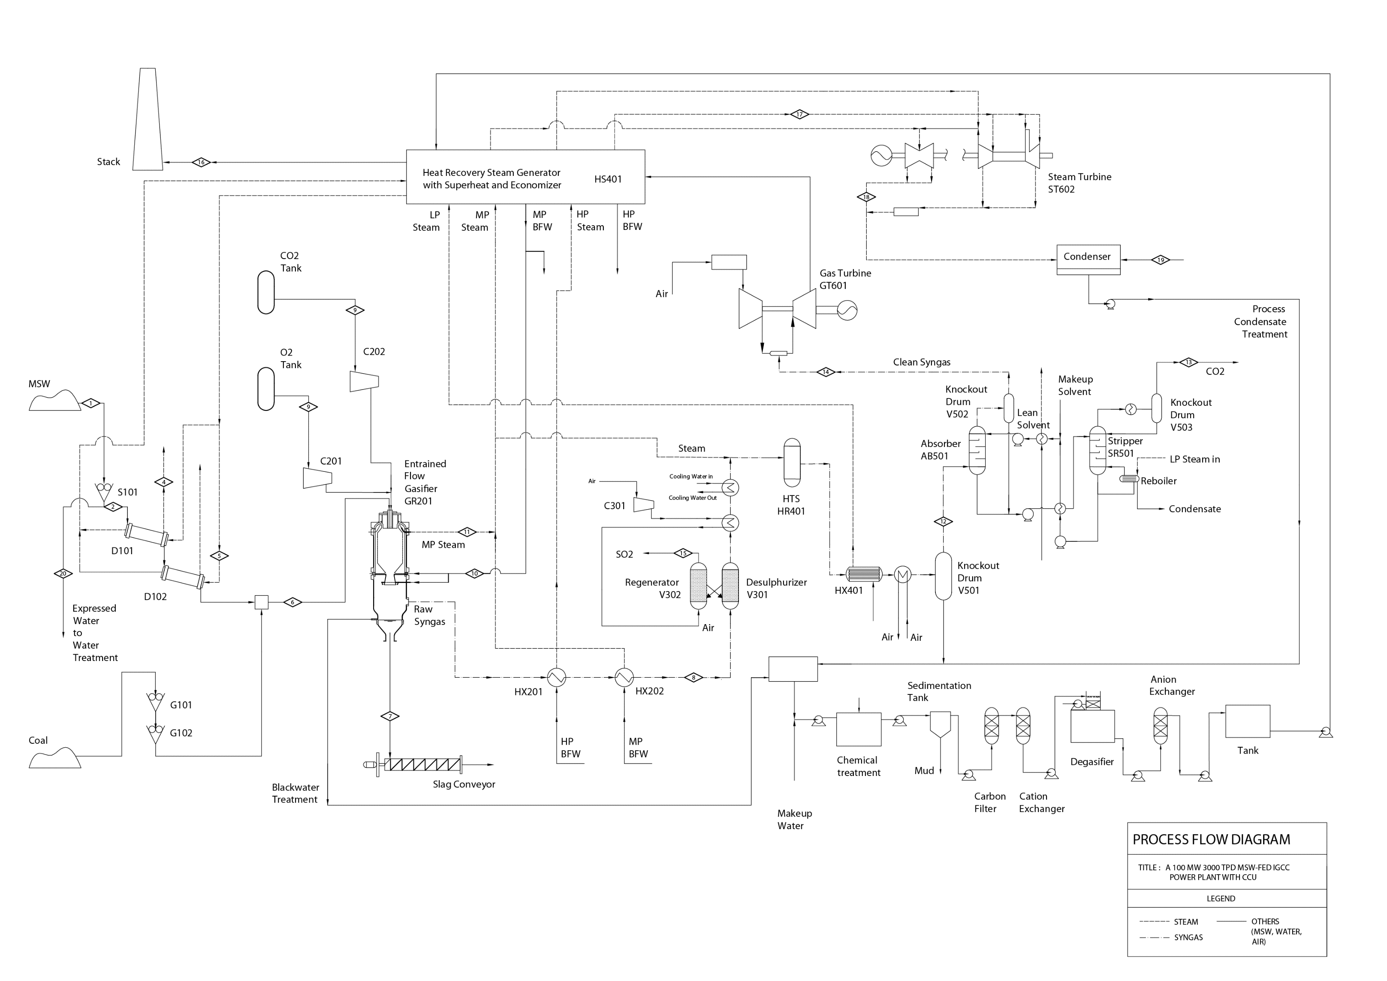
Process Flow Diagram

Slide 26
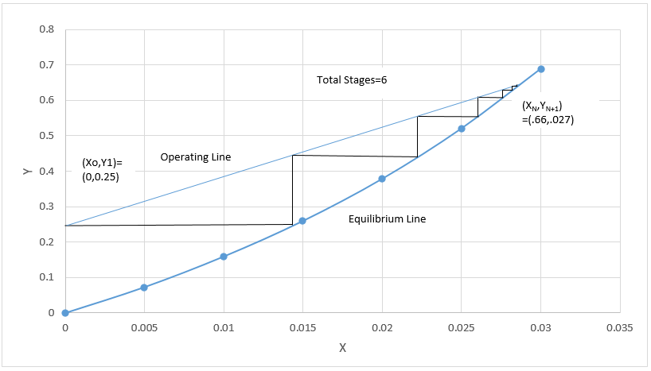
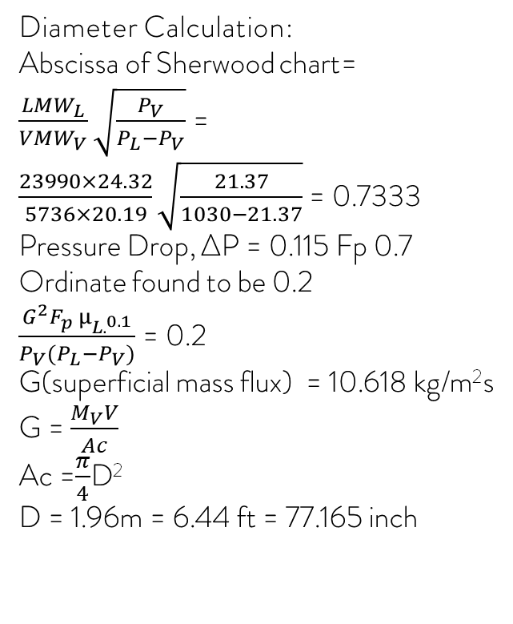
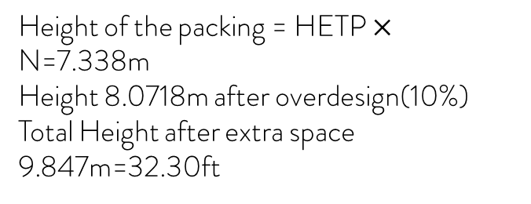
Design: CO₂ Capture Absorber Column
Height Calculation:
D>.5m
HETP=D^{.3} =1.223m
Solvent : 70% MEA
Temp: 35º C
Pressure 2667 KPa
Material : Carbon Steel
McCabe Thiele Diagram
Diameter Calculation:
Abscissa of Sherwood chart= $\frac{LMW_{L}}{VMW_{V}}\sqrt{\frac{P_{V}}{P_{L}−P_{V}}}$ = $\frac{23990×24.32}{5736×20.19}\sqrt{\frac{21.37}{1030−21.37}}$ = 0.7333
Pressure Drop, ∆P = 0.115 Fp 0.7
Ordinate found to be 0.2
$\frac{G^{2}F_{p} μ_{L.^{0.1}}}{P_{V}(P_{L}−P_{V})}$ = 0.2
G(superficial mass flux) = 10.618 kg/m²s
G = $\frac{M_{V}V}{Ac}$
Ac =$\frac{π}{4}$D²
D = 1.96m = 6.44 ft = 77.165 inch
Number of stages= 6
Height of the packing = HETP $×$ N=7.338m
Height 8.0718m after overdesign(10%)
Total Height after extra space 9.847m=32.30ft

Slide 27
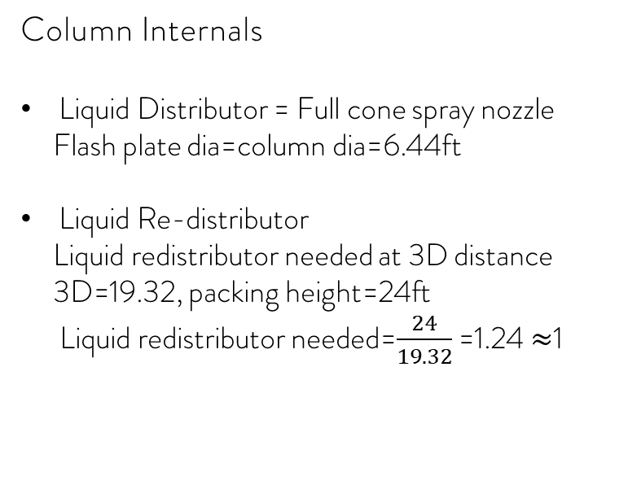
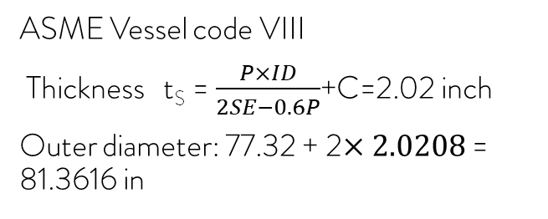
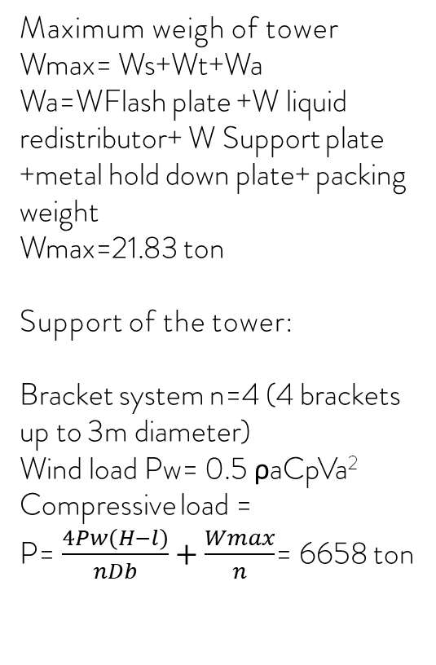
Shell Thickness
Design: CO₂ Capture Absorber Column
Maximum weigh of tower
Wmax= Ws+Wt+Wa
Wa=WFlash plate +W liquid redistributor+ W Support plate
+metal hold down plate+ packing weight
Wmax=21.83 ton
Support of the tower:
Bracket system n=4 (4 brackets up to 3m diameter)
Wind load Pw= 0.5 ρaCpVa²
Compressive load =
P= $\frac{4Pw\left(H−l\right)}{nDb}+\frac{Wmax}{n}$= 6658 ton
ASME Vessel code VIII
Thickness t_{S} = $\frac{P×ID}{2SE−0.6P}$+C=2.02 inch
Outer diameter: 77.32 + 2$×2.0208$ = 81.3616 in
Column Internals
Liquid Distributor = Full cone spray nozzle
Flash plate dia=column dia=6.44ft
Liquid Re-distributor
Liquid redistributor needed at 3D distance
3D=19.32, packing height=24ft
Liquid redistributor needed=$\frac{24}{19.32}$ =1.24 $≈$1

Slide 28
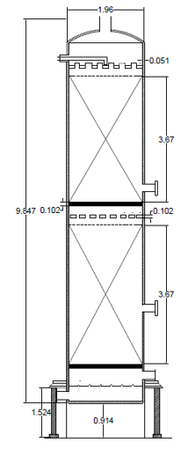
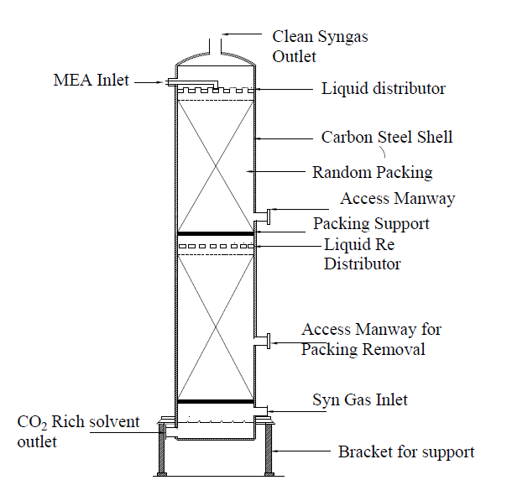
Schematic
Fig: Schematic Diagram of absorber column
Fig: Mechanical Drawing of absorber column

Slide 29
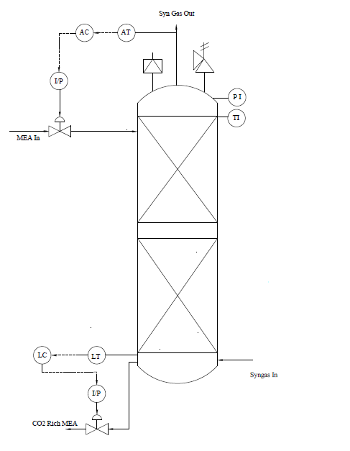
P&ID of CO₂ Capture Absorber Column

Slide 30
List of Major Equipment
Equipment Name | Identification No. | Count
MSW Shredder | S101, | 4
Coal Grinder | G101, G102 | 3
Steam Kiln Dryer | D101, D102 | 2
Entrained Flow Gasifier | GR201 | 1
Quench Vessel | V201 | 1
Catalytic Desulphurizer | V301 | 1
Catalytic Regenerator | V302 | 1
Knockout Drums | V501, V502, V503 | 3
Syngas Cooler | HX201 | 1
Waste Heat Boiler | HX202, HX401 | 2
High Temperature Shift Reactor | HR401 | 1
CO2 Absorber | AB501 | 1
CO2 Stripper | SR501 | 1
Heat Recovery Steam Generation System | HS601 | 1
Gas Turbine | GT601 | 1
Steam Turbine (3 P) | ST602 | 1
Equipment Name | Id No. | Count
O2 Compressor | C201 | 1
CO2 Compressor | C202 | 1
Air Compressor | C301 | 1
Equipment Name | Id No. | Count
Fresh Solvent Pump | P301 | 1
Rich Solvent Pump | P302 | 1
Lean Solvent Pump | P303 | 1

Slide 31
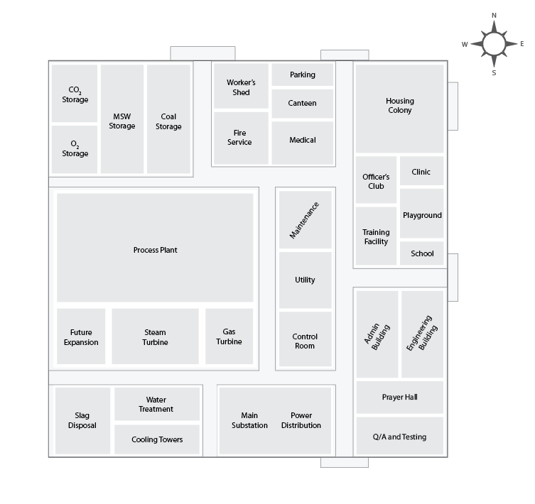
Plot Plan

Slide 32
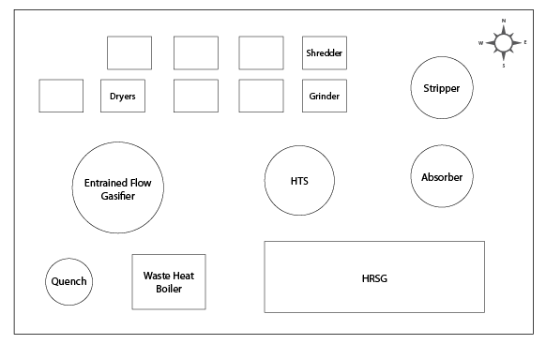
Equipment layout

Slide 33
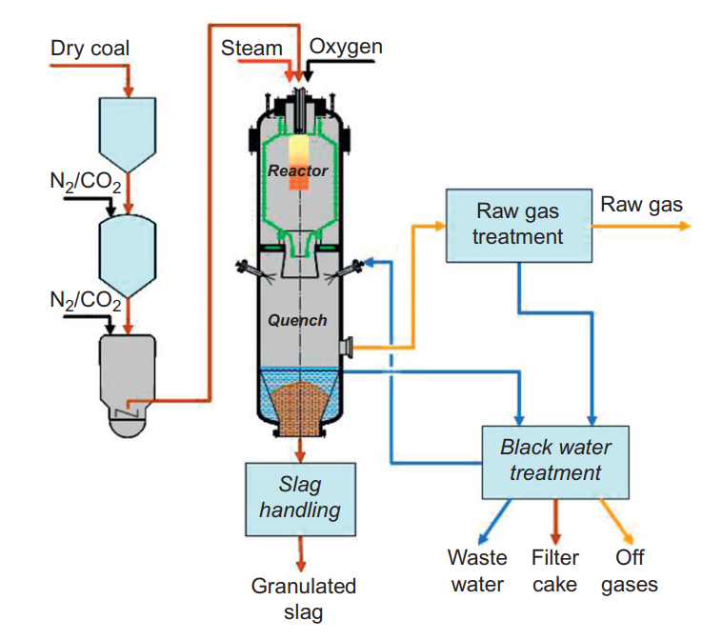
Design: Entrained Flow Gasifier
General Schematic of Siemens SFG gasification island
Ref: Integrated Gasification Combined Cycle (IGCC) Technologies: Ting Wang, Gary Stiegel

Slide 34
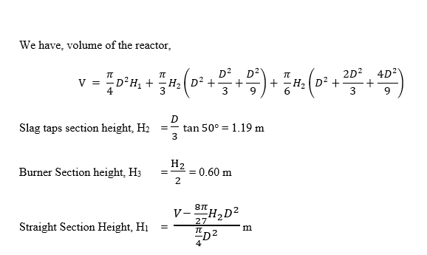
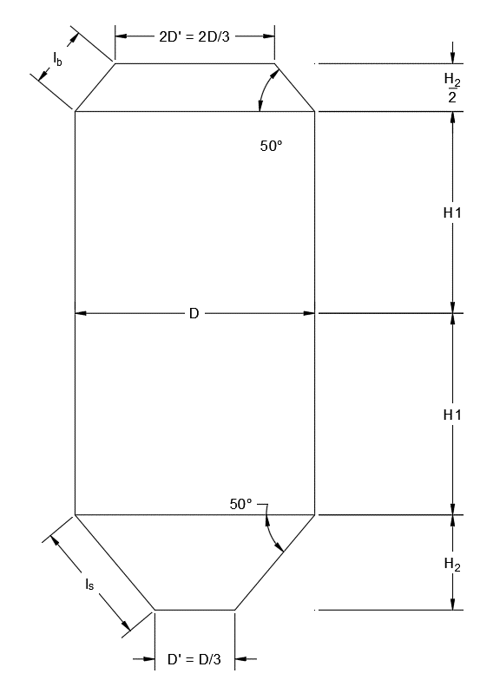

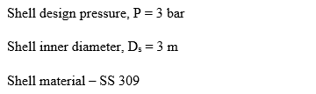
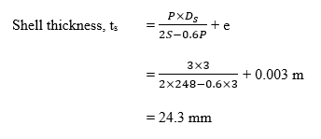
Sizing: Entrained Flow Gasifier

Slide 35
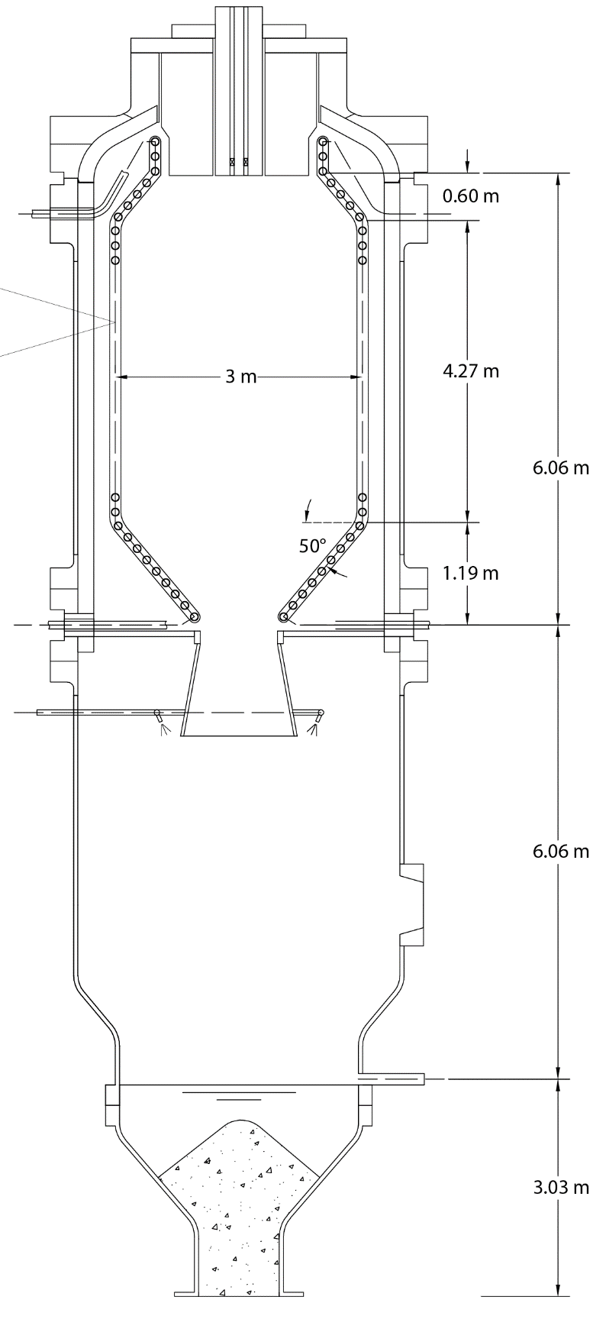
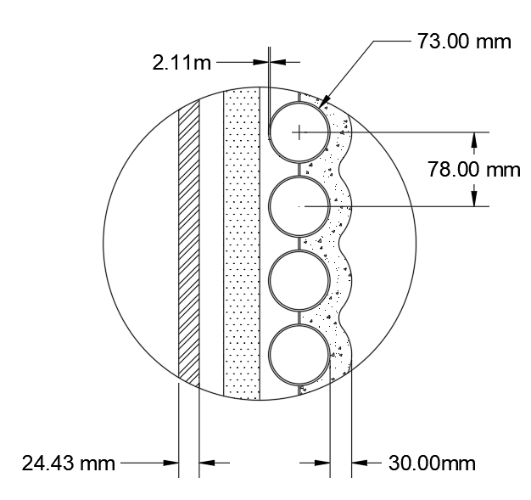
Schematic: Entrained Flow Gasifier

Slide 36
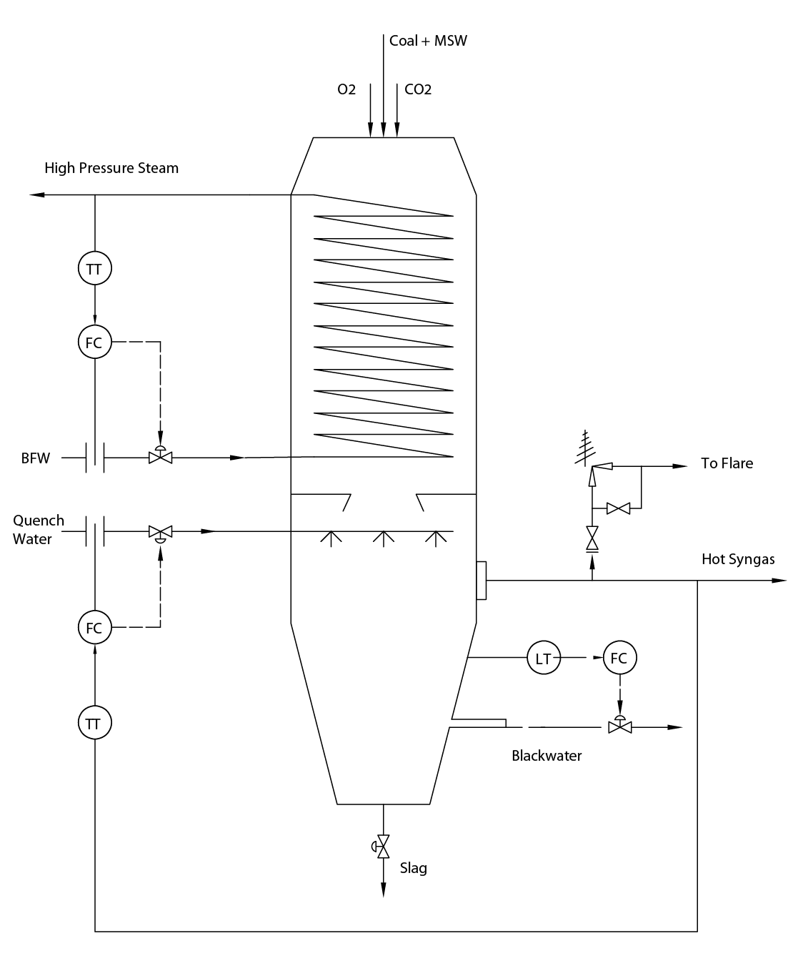
P&ID: Entrained Flow Gasifier

Slide 37
Economic Analysis
FCI
Operational Cost
Depreciation (MACRS 7 years)
Tax
Revenue
Payback Period, IRR

Slide 38
Economic Analysis
Purchased Equipment (PE) Cost = 30% of FCI. Find PE, Find FCI!
Total PE Cost = 65.6 million USD
So FCI = 218 million (USD)
Where Indirect Costs are 76.4 million USD (35% of FCI) and Direct Costs are 142 million USD Indirect Costs include Legal expenses, Engineering and supervision, construction expenses, Contingency
Direct costs include PE cost, installation costs, piping, instrumentation, electrical, buildings, auxiliary plants (WTP, storage etc), Land cost, service facilities, offsites.
The plant is divided into 5 blocks
1. The Gasifier block:
Raw material treatment and gasification equipment
2. The Syngas Cleaning Block:
Desulfurizer and shift-reactors
3. The CO₂ Absorption Block: Absorber Stripper
4. The Energy Block: Gas Turbine, Steam Turbine, Generators, Compressors
5. The Heat Recovery Steam Generator (HRSG): Network of Heat Exchangers
USD 41.1 million (2019)
USD 3.70 million (2019)
USD 570,000 (2019)
USD 17.8 million (2019)
USD 2.50 million (2019)

Slide 39
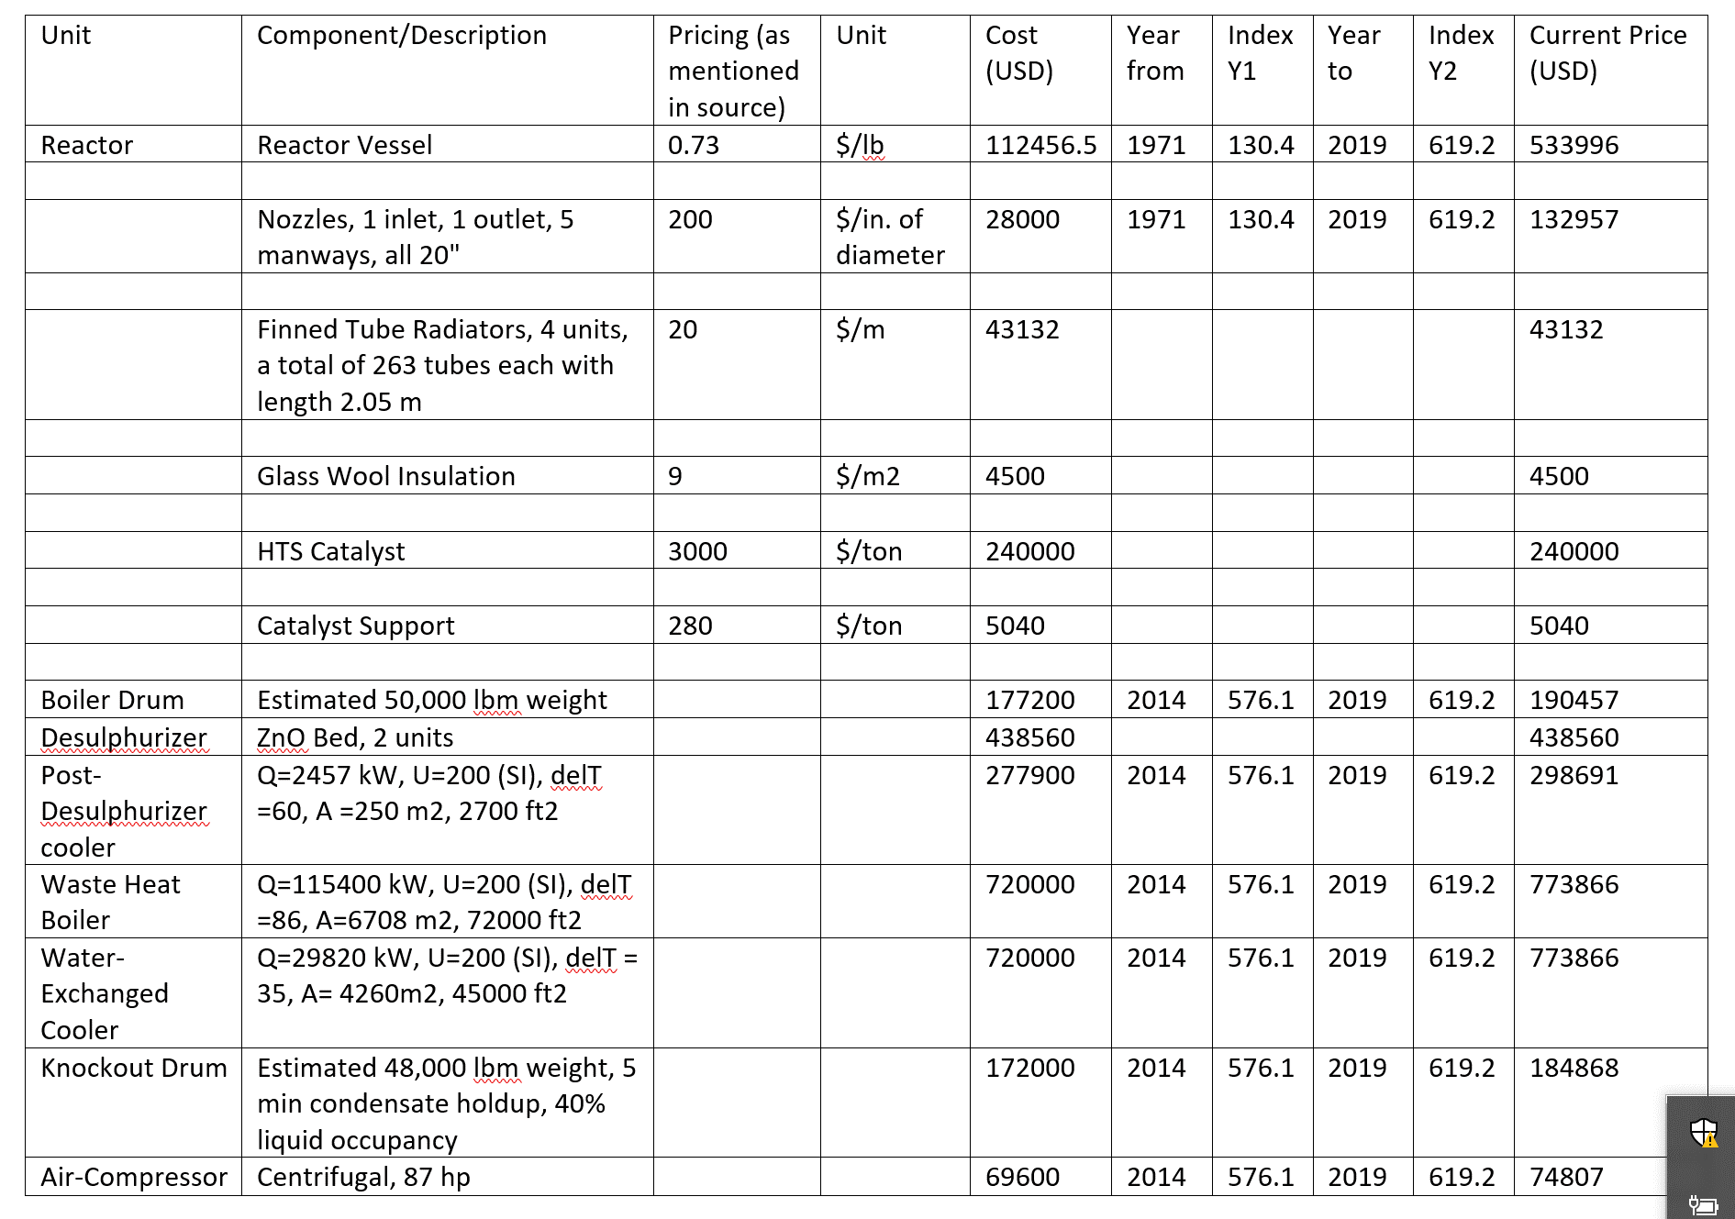
Economic Analysis

Slide 40
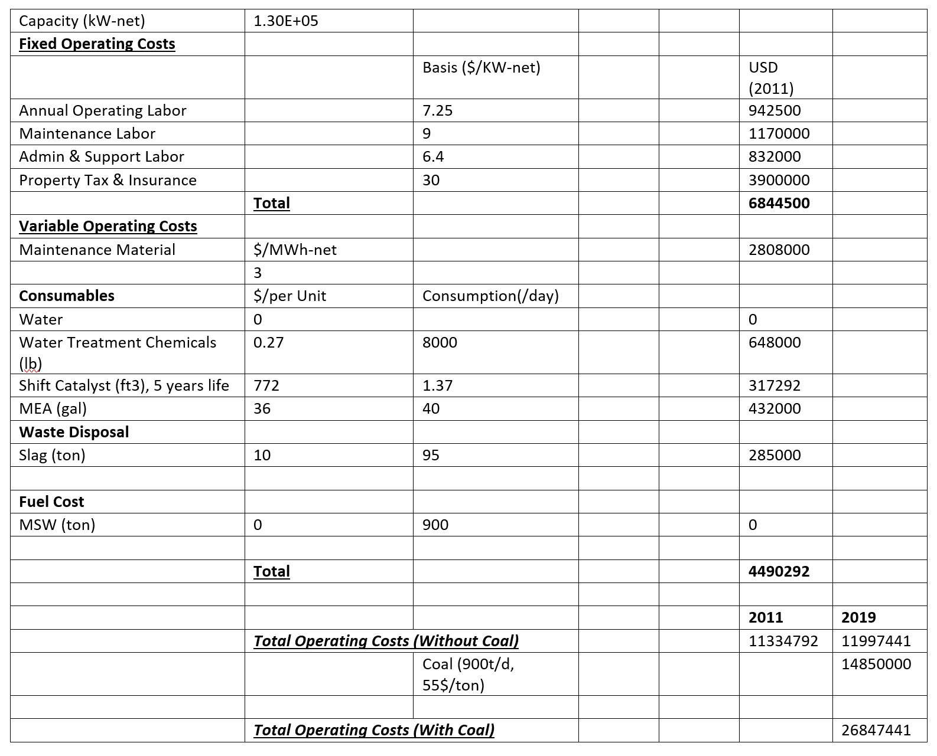
Operating Costs
Ref: Zoelle, A., Keairns, D., Turner, M. J., Woods, M., Kuehn, N., Shah, V., ... & Fout, T. (2015). Cost and Performance Baseline for Fossil Energy Plants Volume 1b: Bituminous Coal (IGCC) to Electricity Revision 2b–Year Dollar Update (No. DOE/NETL-2015/1727). NETL.

Slide 41
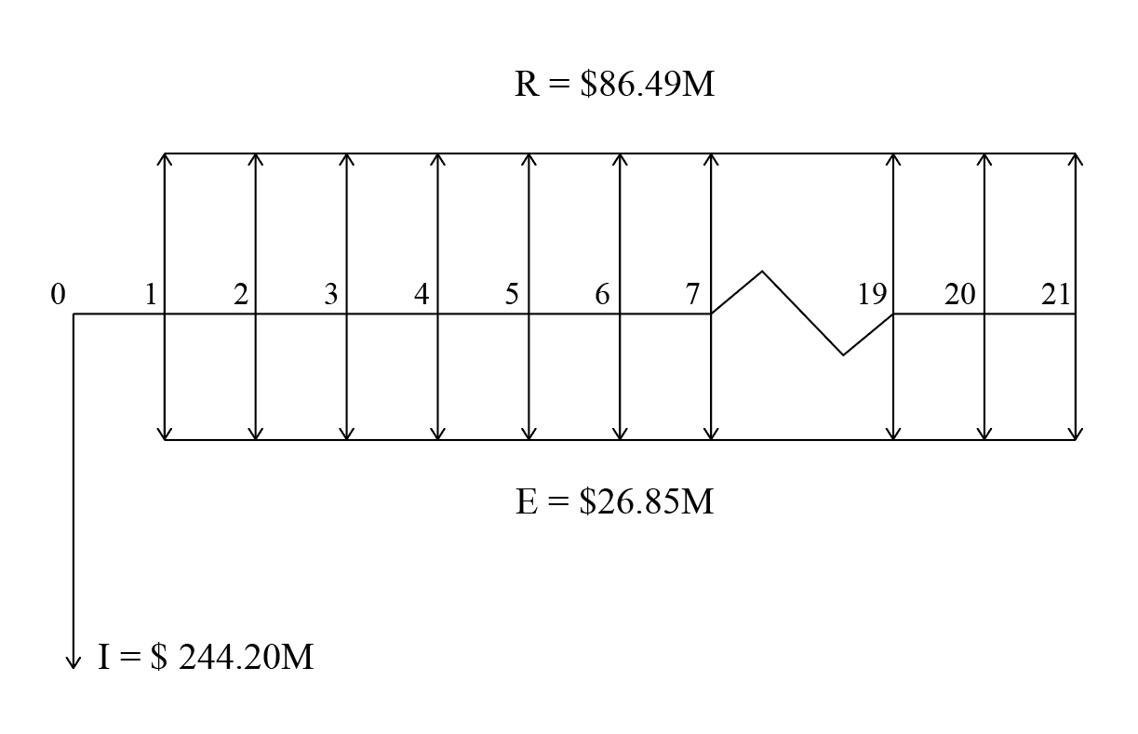
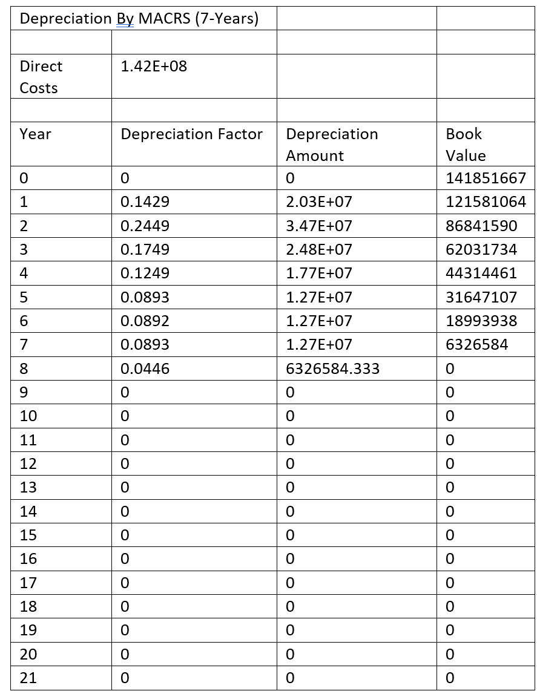
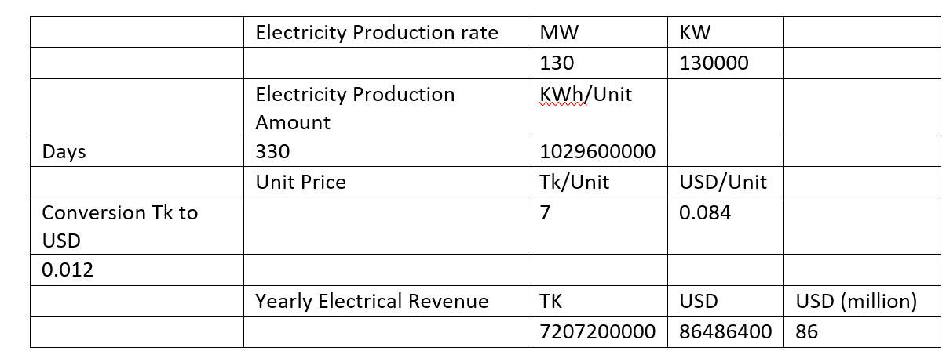
Cashflow, Revenue and Depreciation
Cashflow
Depreciation
PW (@10%) = $ 760M
IRR is 12.74%
Revenue
Ref: Sullivan, W. G., Wicks, E. M., & Luxhoj, J. T. (2003). Engineering economy (Vol. 12). Upper Saddle River, NJ: Prentice Hall.

Slide 42
Payback Period
Gross Profit = Annual Revenue – (Depreciation + Annual Operating Costs)
Net Profit = Gross Profit – Tax
Net Annual Cash Flow = Net Profit + Depreciation
10% MARR Tax = 35 % on Gross Profit 21 year Project Life IRR is 12.74%

Slide 43
Design: High Temperature Shift Reactor
CO+ H₂O = CO₂+ H_{2 ,} Exothermic
Is a heterogenous catalytic reaction where Fe₂O₃ is the catalyst promoted by Cr₂O₃ (chromia)
In an IGCC-CCS system, this reactor serves two purposes
Increase the CO₂ partial pressure (Dry Basis) for efficient absorption.
Produce a cleaner syngas (low CO content) with higher H₂ fraction.
Ref: 1. Rase, H. F., & HOLMES, J. R. (1977). Case studies and design data.
2. Rase, H. F. (1977). Chemical reactor design for process plants (Vol. 2). New York: Wiley.
3. Bednar, H. H., & Bednar, H. H. (1986). Pressure vessel design handbook.
4. Pis’mennyi, E., Polupan, G., Carvajal-Mariscal, I., Sanchez-Silva, F., & Pioro, I. (2016). Handbook for Transversely Finned Tube Heat Exchanger Design. Academic Press.

Slide 44
Catalyst Requirement, How much catalyst do we need?
Skirt Design, What’s the thickness & number of bolts?
Flow Configuration, What’s the (minimum) mass flux?
Wind & Earthquake loading, What’s the bending moment & shear force at the base?
Reactor Sizing, What’s the diameter & length of the reactor?
Reactor Deadweight
Insulation, What’s the thickness?

Slide 45
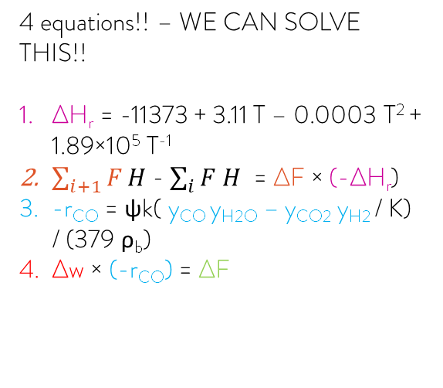
Design: High Temperature Shift Reactor
Catalyst Requirement : Determined by A finite element analysis.
4 unknowns
1. Extent of reaction.
2. Heat of reaction (at temperature 632.5).
3. Reaction rate
(moles converted/lb catalyst)
4. Amount of catalyst, W.
T = 633 ºF, 29 bar
Outlet moles unknown
Outlet specific enthalpy known
-(i+1) -th step
Inlet Conditions: Known
29 bar, 632 ºF , -(i)-th step
Inlet moles and enthalpy known
W lb Catalyst
4 equations!! – WE CAN SOLVE THIS!!
ΔH_{r} = -11373 + 3.11 T – 0.0003 T² + 1.89×10⁵ T⁻¹
$\sum_{i+1}{F}H$ - $\sum_{i}{F H}$ = ΔF × (-ΔH_{r})
-r_{CO} = ψk( y_{CO} y_{H2O} – y_{CO2} y_{H2} / K) / (379 ρ_{b})
Δw × (-r_{CO}) = ΔF
4420 lbmol/hr CO
22100 lbmol/hr H₂O
1055 lbmol/hr CO₂
2890 lbmol/hr H₂ 214 lbmol/hr N₂
Using eq 1 & 2, we can find heat of reaction ΔH_{r} & extent of reaction ΔF After knowing outlet composition, we know, reaction rate –r_{co} , knowing ΔF & –r_{co} gives us W

Slide 46
Design: High Temperature Shift Reactor
Keep repeating until temperature reaches 790 ºF (catalyst deactivation temperature is 890 ºF). If desired conversion is not reached cool it down and use a 2nd (and 3rd / 4th / 5th ) bed! And finally, using 5 beds, we got-
A 91.54 % conversion of CO.
Outlet temperature is 770 ºF, Dry basis CO is 2.96%
1st bed mass = 22,450 lb conversion after 1st bed= 28.746%
2nd bed mass = 14,620 lb conversion after 2nd bed= 45.23%
3rd bed mass = 21,143 lb conversion after 3rd bed= 61.82%
4th bed mass = 36,711 lb conversion after 4th bed= 78.52%
5th bed mass = 80,223 lb conversion after 5th bed= 91.54%
Outlet flowrates F_{CO} = 373.72 lbmol/hr F_{H2O} = 18,049 lbmol/hr F_{CO2} = 5,100.9 lbmol/hr F_{H2} = 6,937.4 lbmol/hr F_{N2} = 213.97 lbmol/hr

Slide 47
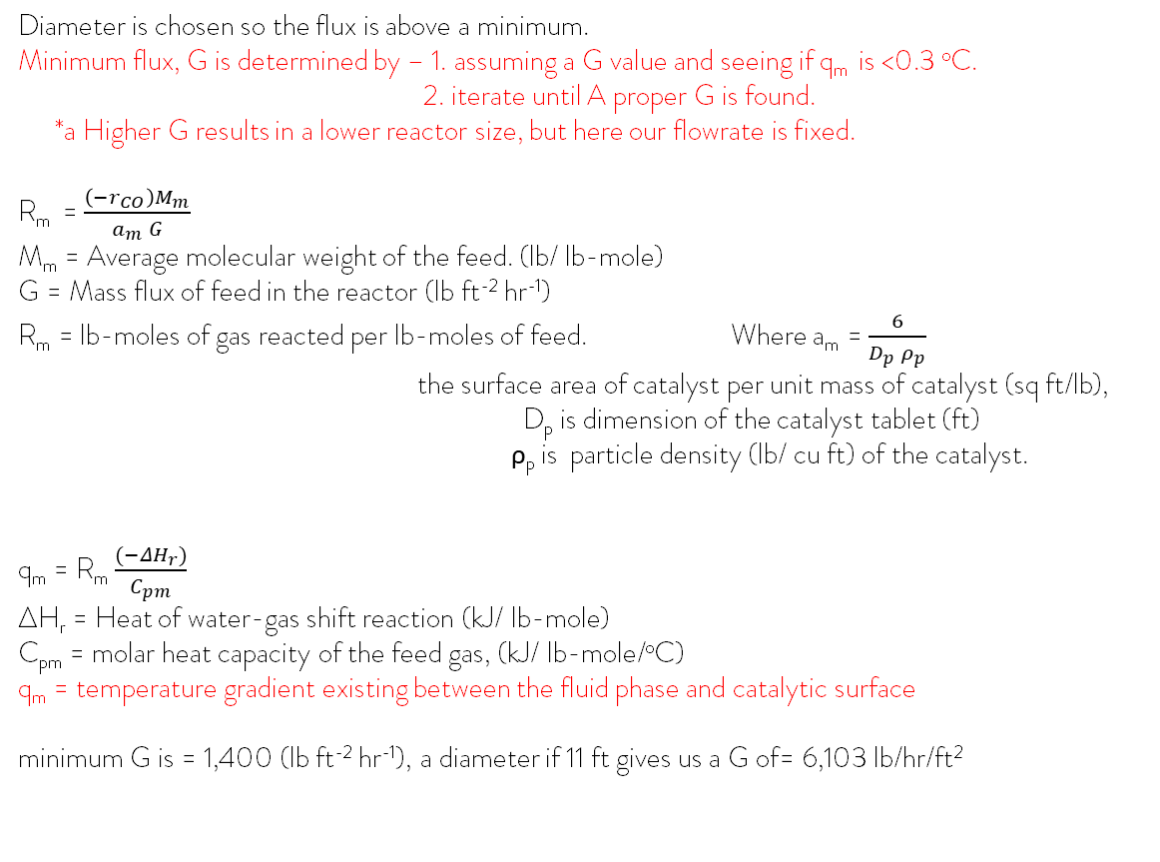
Flow Configuration & Sizing
Diameter is chosen so the flux is above a minimum.
Minimum flux, G is determined by – 1. assuming a G value and seeing if q_{m} is <0.3 ºC.
2. iterate until A proper G is found.
*a Higher G results in a lower reactor size, but here our flowrate is fixed. R_{m} = $\frac{\left(−r_{CO}\right)M_{m}}{a_{m} G}$ M_{m} = Average molecular weight of the feed. (lb/ lb-mole) G = Mass flux of feed in the reactor (lb ft⁻² hr⁻¹) R_{m} = lb-moles of gas reacted per lb-moles of feed. Where a_{m} = $\frac{6}{D_{p} ρ_{p}}$ the surface area of catalyst per unit mass of catalyst (sq ft/lb), D_{p} is dimension of the catalyst tablet (ft) ρ_{p} is particle density (lb/ cu ft) of the catalyst.
q_{m} = R_{m} $\frac{(−ΔH_{r})}{C_{pm}}$ ΔH_{r} = Heat of water-gas shift reaction (kJ/ lb-mole) C_{pm} = molar heat capacity of the feed gas, (kJ/ lb-mole/ºC) q_{m} = temperature gradient existing between the fluid phase and catalytic surface minimum G is = 1,400 (lb ft⁻² hr⁻¹), a diameter if 11 ft gives us a G of= 6,103 lb/hr/ft²
A height of 40 ft cylindrical vessel can accommodate the 5 catalyst beds with adequate spacing.
Skirt height 7.25 ft & Top elliptical head is 2.75 ft. TH = 50 ft.

Slide 48
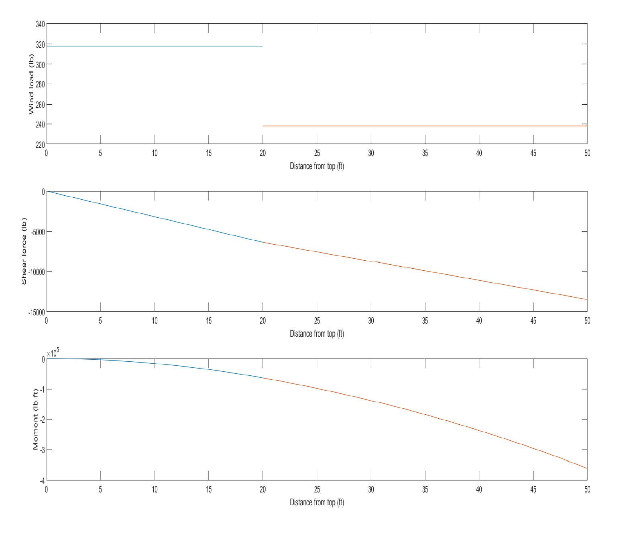
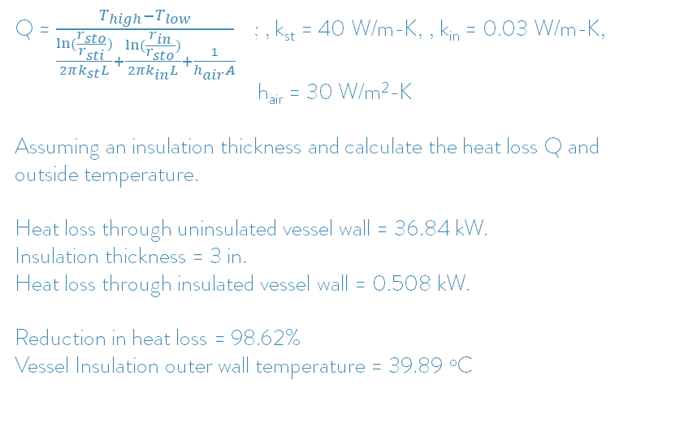
Insulation
Wind velocity was 100 mph for moment at the base
The reactor is assumed to be a cantilever beam with distributed loadings for wind and earthquake loading calculations. The standard used was ASA A58.1-1955
Shear loads due to earthquake was 410 kips Seismic Moment at base was 2751.8 kips
Moment at base due to wind was 361040 lb-ft
Q = $\frac{T_{high}−T_{low}}{\frac{ln⁡(\frac{r_{sto}}{r_{sti}})}{2πk_{st}L}+\frac{ln⁡(\frac{r_{in}}{r_{sto}})}{2πk_{in}L}+\frac{1}{h_{air}A}}$ ; , k_{st} = 40 W/m-K, , k_{in} = 0.03 W/m-K,
h_{air} = 30 W/m²-K
Assuming an insulation thickness and calculate the heat loss Q and outside temperature.
Heat loss through uninsulated vessel wall = 36.84 kW. Insulation thickness = 3 in. Heat loss through insulated vessel wall = 0.508 kW. Reduction in heat loss = 98.62% Vessel Insulation outer wall temperature = 39.89 ºC
Reactor Operational Weight (including reacting fluid)
At the base, mass is 410,000 lb Considering- Reactor shell, head, insulation, ladder,
Ladder clips, support plate, fluid, catalyst, catalyst support, skirt shell, stiffening rings, thermowell, nozzles, finned tube radiator.

Slide 49
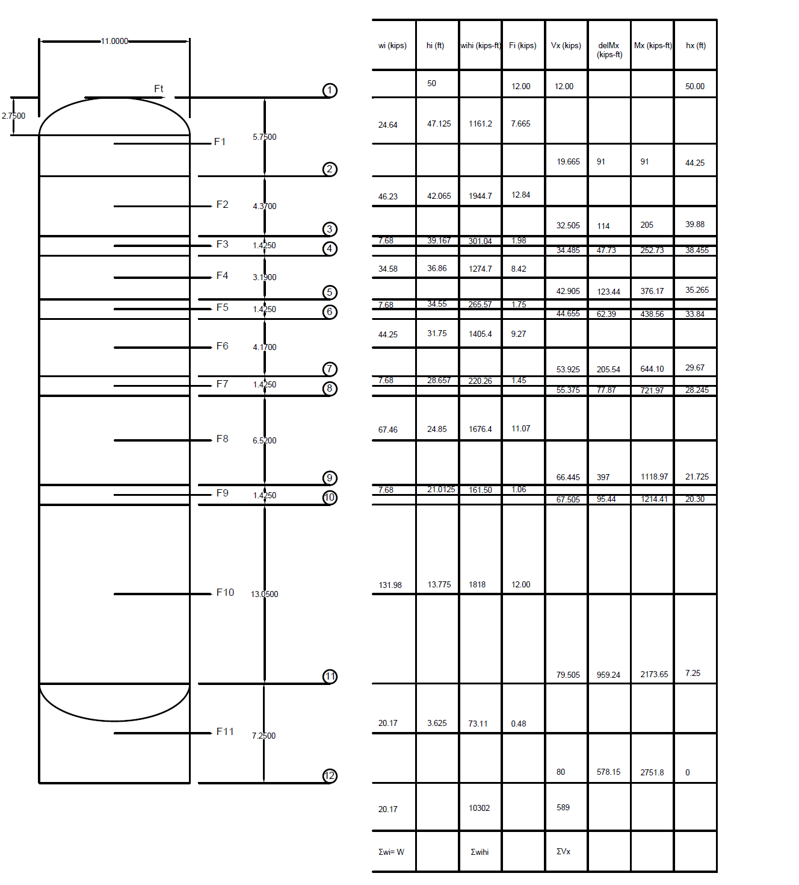
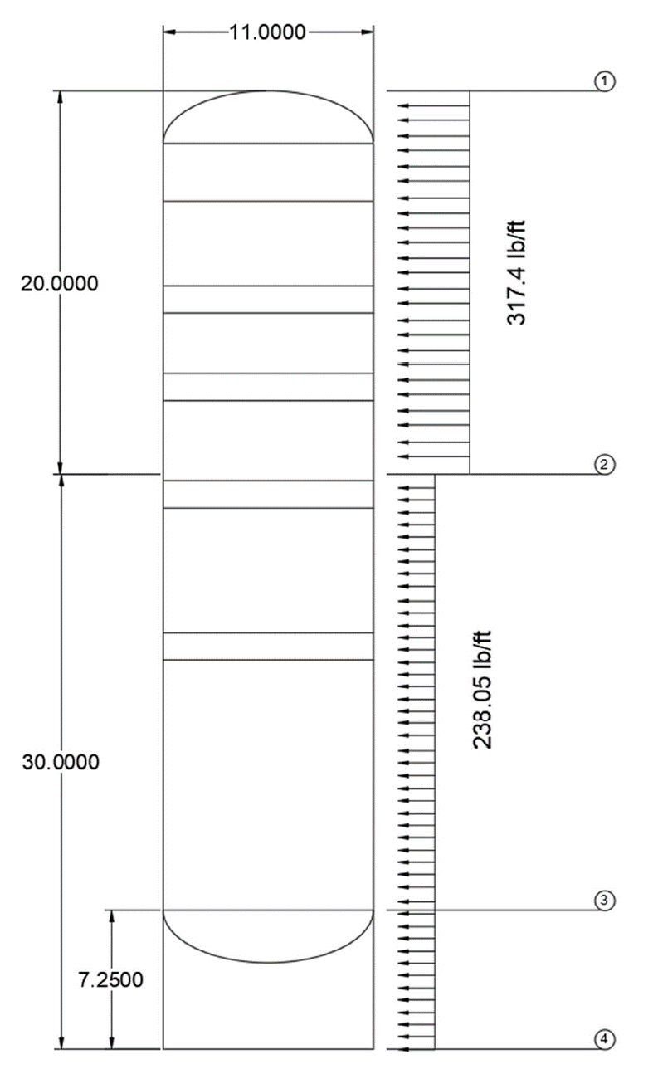
Seismic Loading
Wind Loading

Slide 50
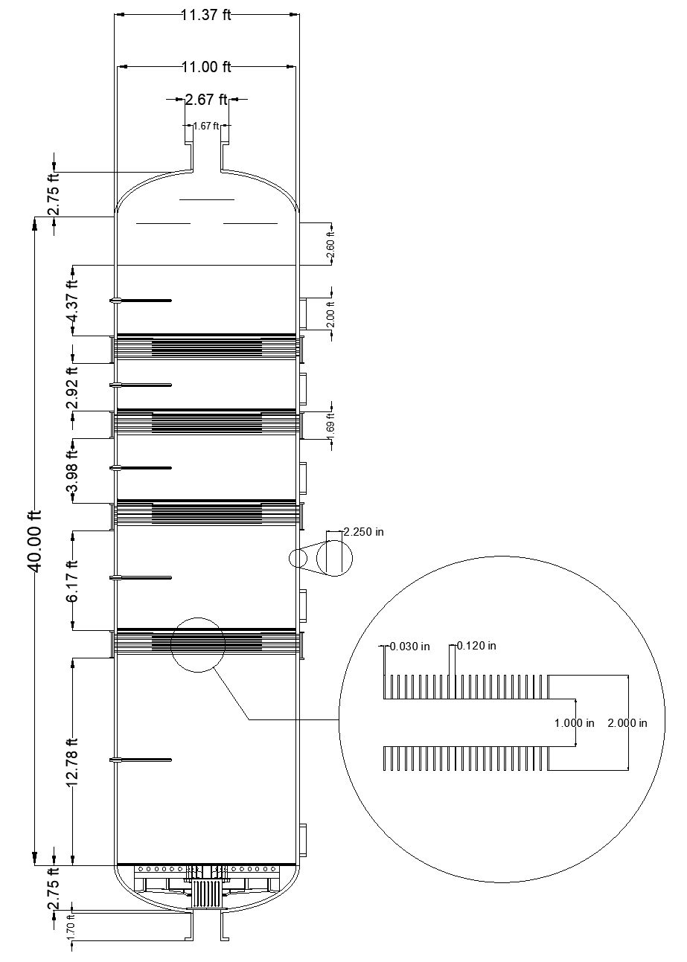
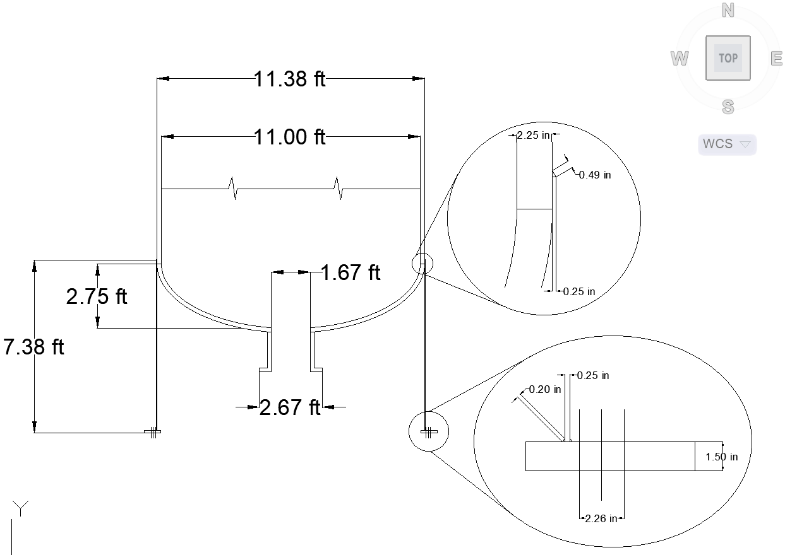
Schematic: High Temperature Shift Reactor

Slide 51
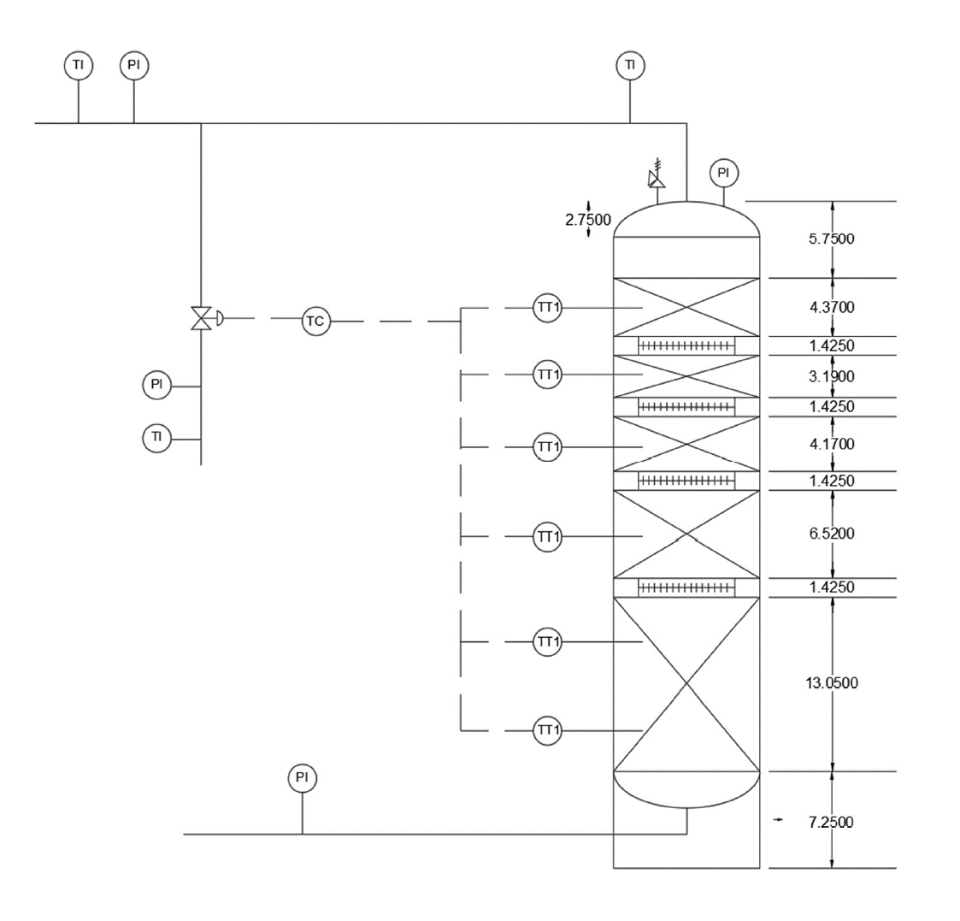
P&ID: High Temperature Shift Reactor

Slide 52

Thank You

